Slide 1
GIT for beginners
Tracking, accessibility and collaboration

Slide 2
Contents
Background on version control and GIT
Configure and initialize a repo
Creating a GitHub account and pushing local repo to online repo
Everyday-git-commands

Slide 3
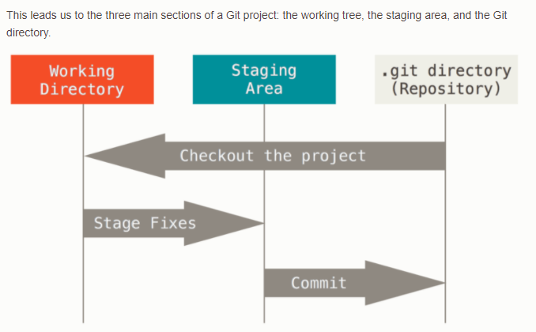
1. Background
Version control
Collaboration with others and accessibility
How GIT approaches version control
https://git-scm.com/book/en/v2/

Slide 4
GIT
Follow the standard download instructions
https://git-scm.com/download/win
https://git-scm.com/download/mac
Feel free to rename “master” to “main” or other preferable names

Slide 5
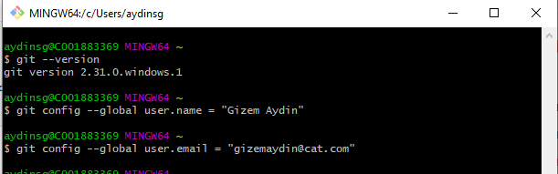
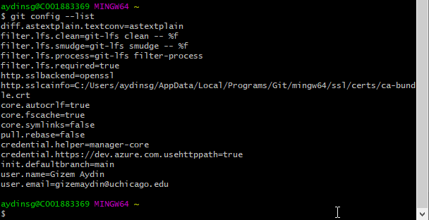
2. Configure and initiate a repo
2.1
Set > global username
> global email Check the configuration

Slide 6
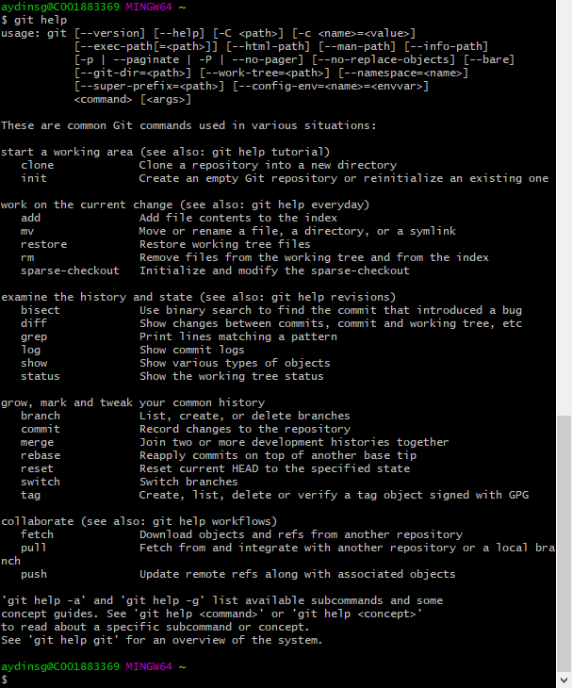
2.2 GIT Help!

Slide 7
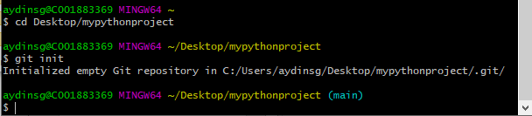
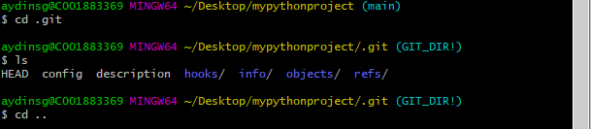

2.3 Initialize a new git repository
Repo = Virtual storage for your project! Each project in GIT is
Step 1: go to the folder you’d like to track (cd desktop/mypythonproject)
Step 2: initialize a git repo by running the “git init” command
Notes:
To create a folder mkdir newFolderName

Slide 8
3. Creating a GitHub account and pushing local repo to online repo
GIT Repo Hosting Services: GitHub, GitLab, BitBucket
Access anytime anywhere, collaboration and contribution

Slide 9
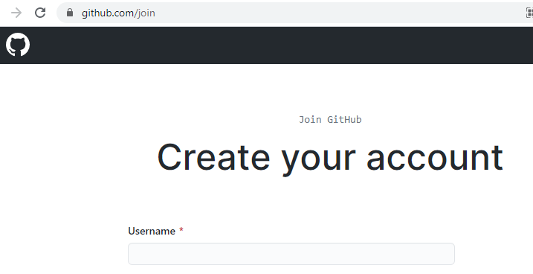
3.1 Creating an account
https://github.com/join
Verify your email, and done!

Slide 10
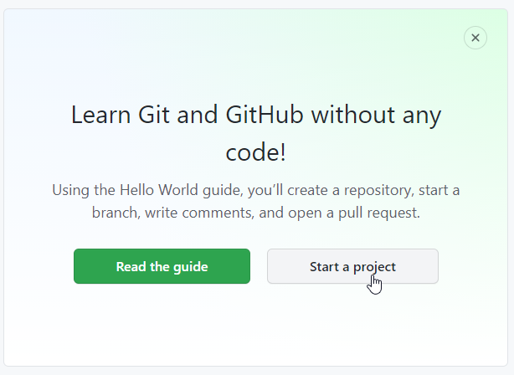

Slide 11
3.2 Quick Start
Create a new repo on the command line
echo “# AydinGizem” >>README.md
git init
git add README.md
git commit –m “first commit”
git remote add origin https://github.com/AydinGizem/teaching-git-hub.git
git push –u origin main
Import code from another repo
xxxx
Push an existing repo from the command line
git remote add origin https://github.com/AydinGizem/teaching-git-hub.git
git push –u origin main

Slide 12
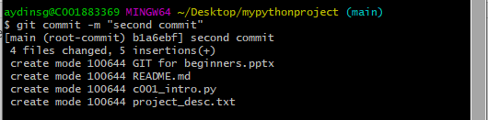
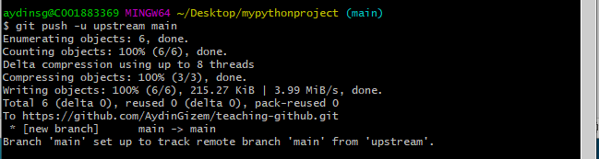
3.3 Push local repo to a code hosting provider
Create a readme file
>> Listed but not tracked yet
Use “git add . “ to add files to stage
Commit with a message: git commit –m “your message”
Connect local repo to GitHub using “add remote origin “ + HTTPS
Now the “upstream” folder is tracked in the “main” branch in your git repo!

Slide 13
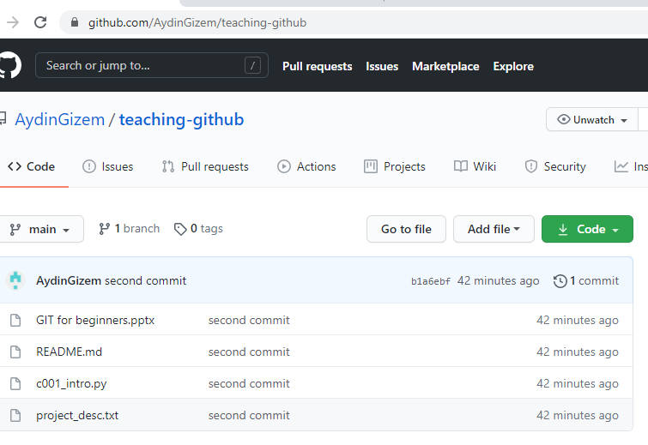
3.4 Check your GitHub repo!

Slide 14
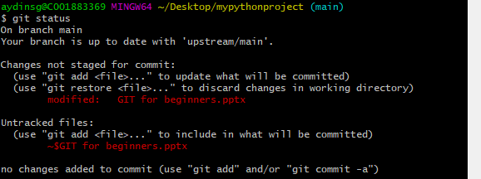
4. Everyday-Git-Commands
(a) “clear” the window
(b) Find out the status of the files using “git status”

Slide 15
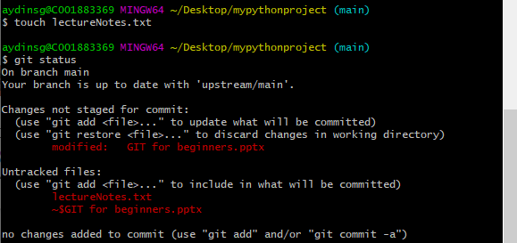
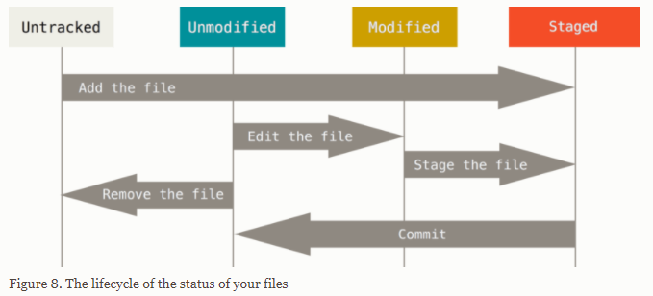
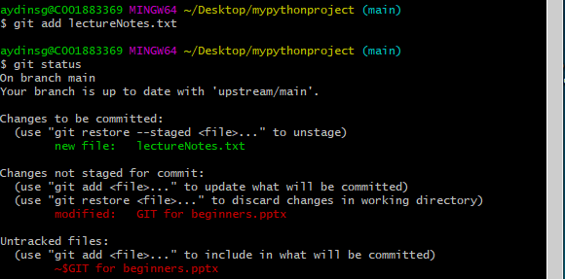
(c) Untracked files can be added using “git add”

Slide 16
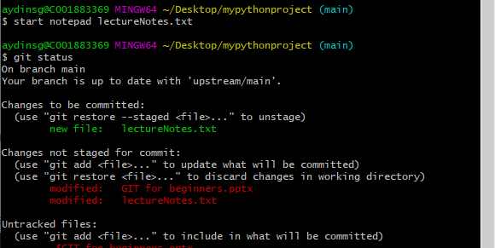
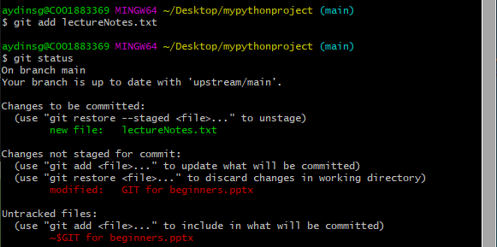
Open file
Make a change
Check the status of the file, not it is “not staged”
Add to the stage
Check the status of the file, it is not staged!

Slide 17


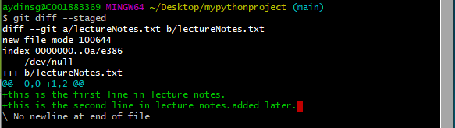
Short status “-s” or “—short”
M = modified
A = will be added
?? = not tracked
Compared files
File metadata
Change markers for file a/b
Chunk header
Chunk changes (add/remove)
Notes:
Git diff –staged –-no-renames : to tell git there are no renamed files

